Slide 1
Software Testing and Quality Assurance
Lecture 16

Slide 2
Agenda
Software Testing from theoretical standpoint
Graph Based Testing

Slide 3
Input and Output Space
Let U be the set of numbers and characters that can be represented on some computer system.
Let I be the input space, and O be the output
space.
– Both I and O are equal to the set of finite sequences of U.

Slide 4
Specifications
A specification is a relation S ⊆ I × O
The input domain of specification S is the set
D^{S} = { i ∈ I | ∃o ∈ O, (i, o) ∈ S }
Ideally, a specification is a total function, which describes an intended behavior of the program for every possible input.
In practice, a specification is a partial function, whose domain is the set of all values for which S is defined.

Slide 5
Programs
A program defines a partial function
P : I → O
The input domain of program P is the set
D^{P} = {i ∈ I | P halts on input i }
= {i ∈ I | P(i) is defined }
Those inputs which cause program P to crash or go into an infinite loop are not in D^{P}

Slide 6
Program Correctness
Program P is correct w.r.t. specification S, iff
D^{S} ⊆ D^{P} and ∀i ∈ DS, (i , P(i)) ∈ S
That is, P is correct w.r.t. S iff for each element i on the input domain of S, P halts on input i , returning a value which is in accordance with the specification.

Slide 7
Testing and Correctness
In order to determine correctness by testing it is necessary to be able to generate a finite set T ⊂ D with the following properties:
– For each t ∈ T there is a computable procedure for determining whether or not P terminates for t.
– {∀t ∈ T, P(t) = S(t)} ⇒ {∀t ∈ D, P(t) = S(t)}

Slide 8
Verification vs. Validation
Verification:
"Are we building the product right?"
The software should conform to its specification.
Validation:
"Are we building the right product?"
The software should do what the user really requires.
8

Slide 9
Verification vs. Validation
Verification:
"Are we building the product right?"
The software should conform to its
specification.
Validation:
"Are we building the right product?"
The software should do what the user really requires.
9

Slide 10
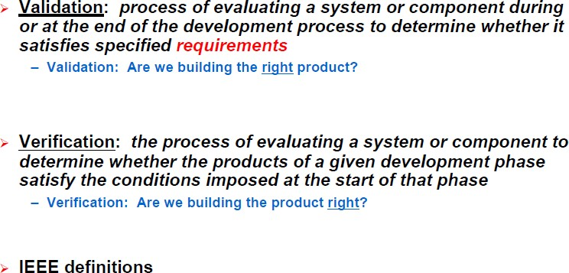
Verification and Validation

Slide 11
The V & V Process
Is a whole life-cycle process - V & V must be applied at each stage in the software process.
Example: Peer document reviews
Has two principal objectives
The discovery of defects in a system
The assessment of whether or not the system is usable in an operational situation
11

Slide 12
The V & V Process
Is a whole life-cycle process - V & V must be applied at each stage in the software process.
Example: Peer document reviews
Has two principal objectives
The discovery of defects in a system
The assessment of whether or not the system is usable in an operational situation
12

Slide 13
V & V Goals
Verification and validation should establish confidence that the software is fit for its purpose.
This does NOT mean completely free of defects.
Rather, it must be good enough for its intended use. The type of use will determine the degree of confidence that is needed.
This leads us to definition of testing
Software testing is the process of analyzing a software item to detect the differences between existing and required conditions (that is, bugs) and to evaluate the features of the software item
13

Slide 14
V & V Confidence
Depends on the system’s purpose, user expectations, and marketing environment
System purpose
The level of confidence depends on how critical the software is to an organization (e.g., safety critical).
User expectations
Users may have low expectations of certain kinds of software
Marketing environment
Getting a product to market early may be more important than finding defects in the program
14

Slide 15
Static vs. Dynamic V & V
Code and document inspections - Concerned with the analysis of the static system representation to discover problems (static v & v)
May be supplement by tool-based document and code analysis
Software testing - Concerned with exercising and observing product behaviour (dynamic v & v)
The system is executed with test data and its operational behaviour is observed
15

Slide 16
Static vs. Dynamic V & V
Code and document inspections - Concerned with the analysis of the static system representation to discover problems (static v & v)
May be supplement by tool-based document and code analysis
Software testing - Concerned with exercising and observing product behaviour (dynamic v & v)
The system is executed with test data and its operational behaviour is observed
16

Slide 17
What, when, how and how much…
What (or what against what) to test?
Is it the code, specification, features …
Answer: at different levels, we bear different perspectives
This could be code, model against requirements
What are requirements?
When to test?
How and how much?
We want to find out when to stop testing

